Slide 1
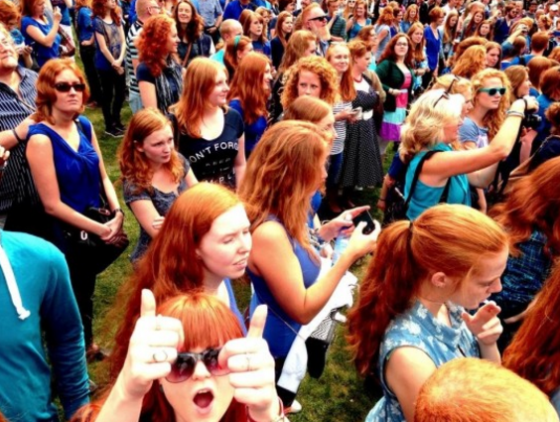
Changes to Allele Frequencies in Gene Pools

Slide 2

Date: | Human Biology Year 12 ATAR
Do Now Get out your equipment and textbook. Lesson Agenda 1: Do Now 2: Changes to Allele Frequencies in Gene Pools 3: Start on the Review Worksheet 4: Lesson summary and wind-up Suggested Study Complete review worksheet, then mark and correct using the answer key on Connect (compulsory). NEXT LESSON Evolution by Natural Selection | Learning Aims List reasons why allele frequency may change within gene pools Define and give examples of gene flow Discuss barriers to gene flow, and provide examples List advantages and disadvantages of barriers to gene flow Define and briefly explain genetic drift Give examples to describe how genetic drift is: Random Non-directional Non-adaptive and not influenced by environment Give an example to show evidence for genetic drift Define and explain the Founder Effect Give an example of the Founder Effect Define and explain the Bottleneck Effect Give an example of the Bottleneck Effect
 | Key Vocabulary Gene Pool Allele Frequency Gene Flow Genetic Drift

Slide 3
Introduction
Allele frequency can change within gene pools
This can be due to:
Gene flow between populations
Random genetic drift including
Founder Effect
Bottleneck Effect
Natural Selection
Learning Aim: List reasons why allele frequency may change within gene pools.

Slide 4
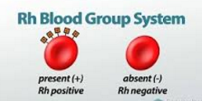
Gene Flow and Allele frequency
Flow of genes from one population to another with human migration and inter-breeding.
Example: Rhesus factor in Chinese population:
In the past, Chinese population was Rh negative (Rh-): no rhesus factor on blood cells.
European traders and sailors in 16th century carried allele for Rhesus factor (Rh +), and interbred with Chinese population.
Some offspring then were Rh+
Frequency of Rh + allele is still low, but greater than it was pre-European gene flow.
Learning Aim: Define and give examples of gene flow.

Slide 5
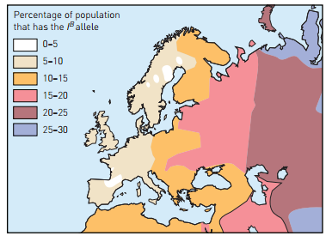
Gene Flow and Allele frequency
Example: ABO blood group distribution:
East Asian populations have greater frequency of B group allele.
Spread into Europe during Mongol invasions of 12th and 13th Centuries.
B group more common in Eastern Europe, decreasing in frequency moving west, in line with exposure to Mongol invaders.
Learning Aim: Define and give examples of gene flow.

Slide 6
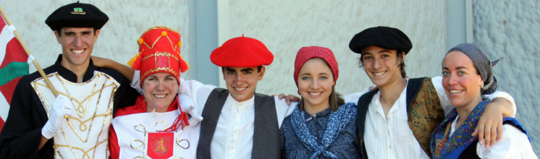
Barriers to Gene Flow
Things that prevent contact and/or interbreeding between populations:
Geographical Barriers
mountain ranges, oceans, big lakes, deserts, ice sheets
Isolation over time means different gene pools develop
Natural selection (more on this later) means advantageous traits for the environment become more common
Socio-cultural Barriers
Different religion, language, cultural practices, social position can also prevent interbreeding between populations
Historical practices of cousin marriage in the Mediterranean to preserve property and power (cultural isolation) have led to a greater frequency of the allele for Beta Thalassemia.
Eg Basque people of the Pyrenees mountains: geographical and cultural isolation → distinctive appearance, unusual blood group allele frequencies.
Learning Aim: Discuss Barriers to gene flow and provide examples.

Slide 7
Barriers to Gene Flow - Disadvantages and Advantages
Disadvantages
Greater incidence of genetic disease
Small/isolated populations:
Marriage between close relatives, eg cousins, are common
Means two carriers of a genetic disease are more likely to marry
Therefore greater incidence of the genetic disease
Advantageous genes won’t enter population through migration
Advantage
Barriers to gene flow mean that lethal recessive alleles from other populations are less likely to enter the isolated population.
Learning Aim: List disadvantages and advantages of barriers to gene flow.

Slide 8
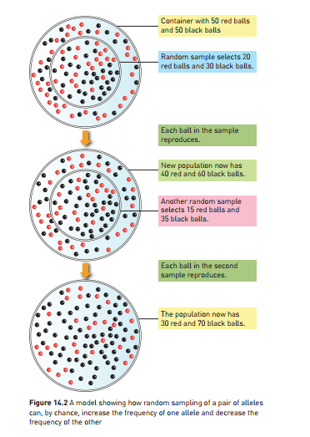
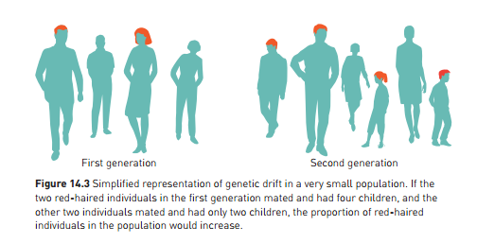
Genetic Drift
Allele frequency change by chance, rather than by natural selection.
Random nature of reproduction can mean some alleles become more frequent by chance.
Happens in all populations, but can have a larger effect in small populations.
Learning Aim: Define and briefly explain genetic drift.

Slide 9
Genetic Drift is Random
Allele frequency changes due to random/chance factors eg:
A subset of the population becoming isolated
Migration and interbreeding between populations
More people with a particular allele having more children through random chance
Change of frequency is neither an advantage nor a disadvantage
Learning Aim: Describe how genetic drift is random.

Slide 10
Genetic Drift is Non-Directional
Frequency of a particular allele can increase and decrease over time due to random factors :
Eg: More red-headed people might randomly have kids in one generation, increasing the allele frequency for red hair, then the next generation they may have less, decreasing the frequency. The generation after that, there may be more again.
Learning Aim: Describe how genetic drift is non-directional.

Slide 11
Genetic Drift is Non-Adaptive and not influenced by the environment
The change in allele frequency doesn’t cause an adaptive advantage in the environment
Doesn’t increase chance of survival or reproduction.
Eg: an random increase in the allele frequency for straight hair doesn’t cause an advantage. The next generation there may be a random decrease based on the randomness in reproduction.
Learning Aim: Describe how genetic drift is non-adaptive and not influenced by the environment.

Slide 12
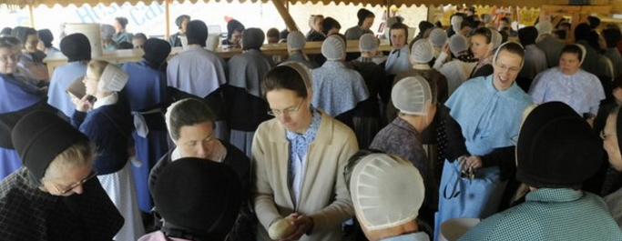
Evidence for Genetic Drift – The “Dunkers”
USA religious sect in Pennsylvania – similar to Amish
Originally from a population of German Baptists from Hesse in Germany – arrived in USA approx 300 years ago.
Only marry and reproduce within their community.
Studies done to comparing allele frequencies Dunkers with surrounding American community AND modern day Germans from Hesse
Dunkers have different allele frequencies to modern day Germans from Hesse AND surrounding American community.
Environment of surrounding mainstream USA community the same as for Dunkers, therefore differences in allele frequency must be due to random drift as natural selection can’t be the reason – same environment.
Learning Aim: Give an example of evidence for genetic drift.

Slide 13
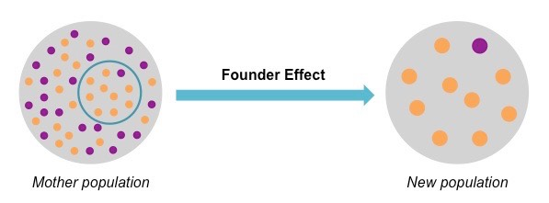
Genetic Drift Example: The Founder Effect
Occurs when a small group moves away from homeland and establishes an isolated community, which later breeds and expands
Small sample of homeland population is not likely to have exact same allele frequency as whole population.
As isolated population expands, so does the new allele frequency.
Learning Aim: Define and explain the Founder Effect

Slide 14
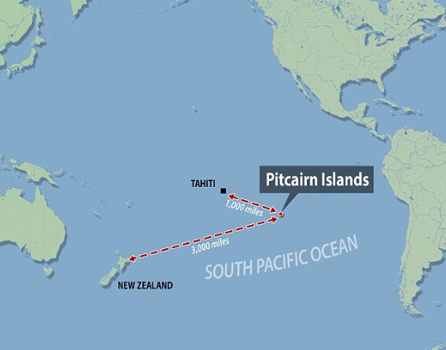
Genetic Drift “Founder Effect” example: Pitcairn Islanders
In 1790, Pitcairn Island was populated by:
9 mutineers from the Bounty
6 men, 12 women Polynesians
Geographical isolation, few newcomers
Descendants show less genetic diversity (and fewer surnames), and different gene frequencies compared to general populations.
Pitcairn Island descendants at greater risk of cardiovascular disease due to this – the original inhabitants would have randomly had a greater allele frequency for cardiovascular disease.
Learning Aim: Give an example of the Founder Effect

Slide 15
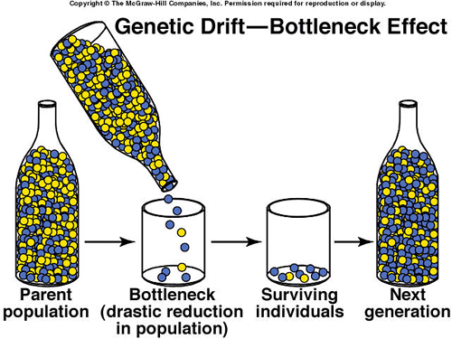
Genetic Drift Example: The Bottleneck Effect
Occurs when natural disaster severely reduces population size of an isolated population:
Small sample of homeland population is not likely to have exact same allele frequency as whole population.
As isolated population expands, so does the new allele frequency.
Learning Aim: Define and explain the Bottleneck Effect

Slide 16
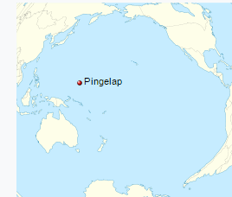
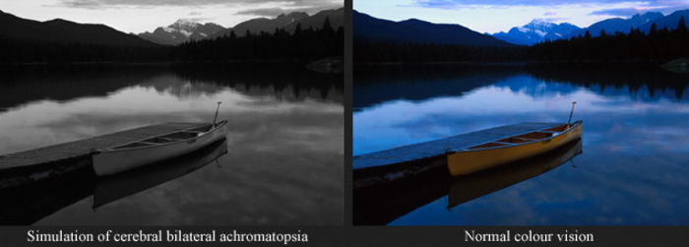
Bottleneck effect example: Pingelap
Pingelap: island in Micronesia
1775: typhoon wiped population down to 20 individuals
Among survivors: one person who carried allele for achromatopsia (total colour blindness)
After multiple generations:
incidence of achromatopsia on Pingelap is 5%
30% of population carriers.
Compare to rest of world: incidence 0.0033%
Learning Aim: Give an example of the Bottleneck Effect.

